Slide 1

WIPRO NGA Program – Embedded Testing
Capstone Project Presentation –21st May To 18th June 2025
Project Title Here – failover clustering with member nodes
Presented by – 28975_Puneet Kumar
www.rpsconsulting.in

Slide 2
Failover Clustering
Failover Clustering in Windows Server 2019 is a feature that allows multiple servers (nodes) to work together to provide high availability (HA) for services and applications. If one server fails, another server in the cluster automatically takes over — ensuring minimal downtime.

Slide 3
Key Concepts of Failover Clustering
Failover Cluster: A group of independent servers (nodes) working together to increase availability.
Cluster Node: A server that is a member of the failover cluster.
Cluster Resource: Services or applications like File Server, SQL Server, VMs, etc., that are made highly available.
Cluster Shared Volumes (CSV): Shared disks that multiple cluster nodes can access simultaneously.

Slide 4
Setup Virtual Mechines
Step 1 – Create the Base Windows Server 2019 VM
Open VMware Workstation.
Create a new VM:
RAM: 8 GB
HDD: 80 GB
Network Adapter: NAT d. Processors : 2
Install Windows Server 2019.
Install VMware Tools.
Disable the firewall.
Rename the computer (e.g., win19base) and reboot.
Verify changes and shut down the VM.

Slide 5
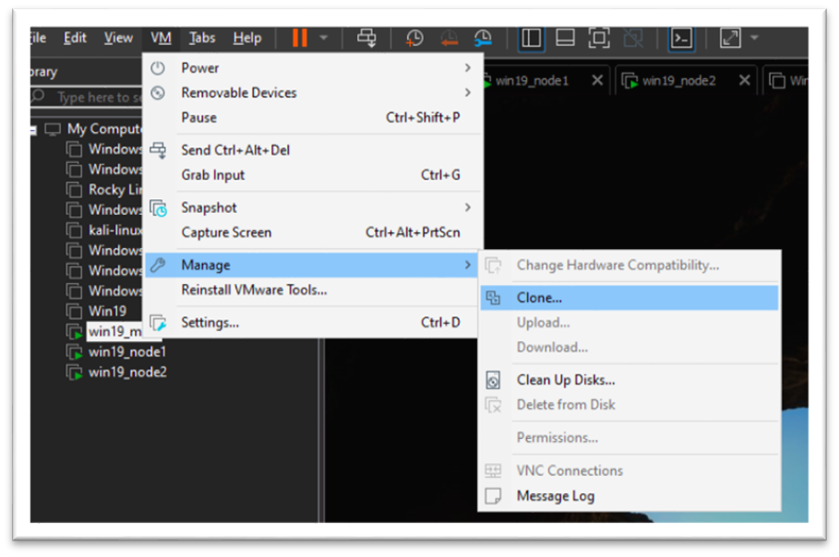
Step 2 – Clone the Base OS
Right-click on the base VM → Manage > Clone

Slide 6
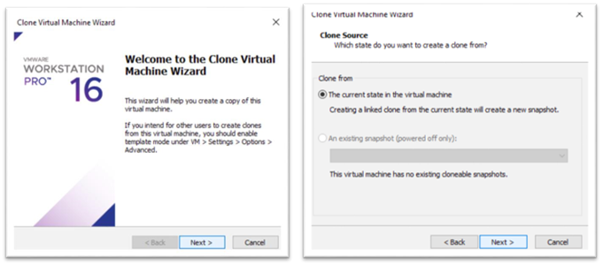
Choose Current State of VM → Next.

Slide 7
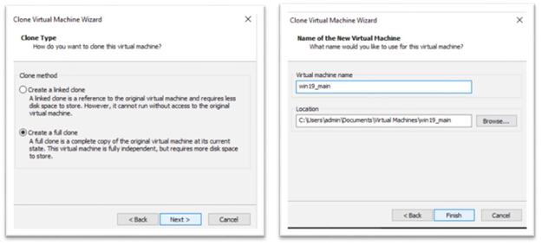
Select Full Clone: • Name: win19_main

Slide 8
Step 3 – Setup Main Server
Set Static Ip to 192.168.1.50
Rename the Os to win19main
Install AD DS and DNS Roles
Server Manager > Add roles and features > Server Roles
Select Active Directory Domain Services and DNS Server and install

Slide 9
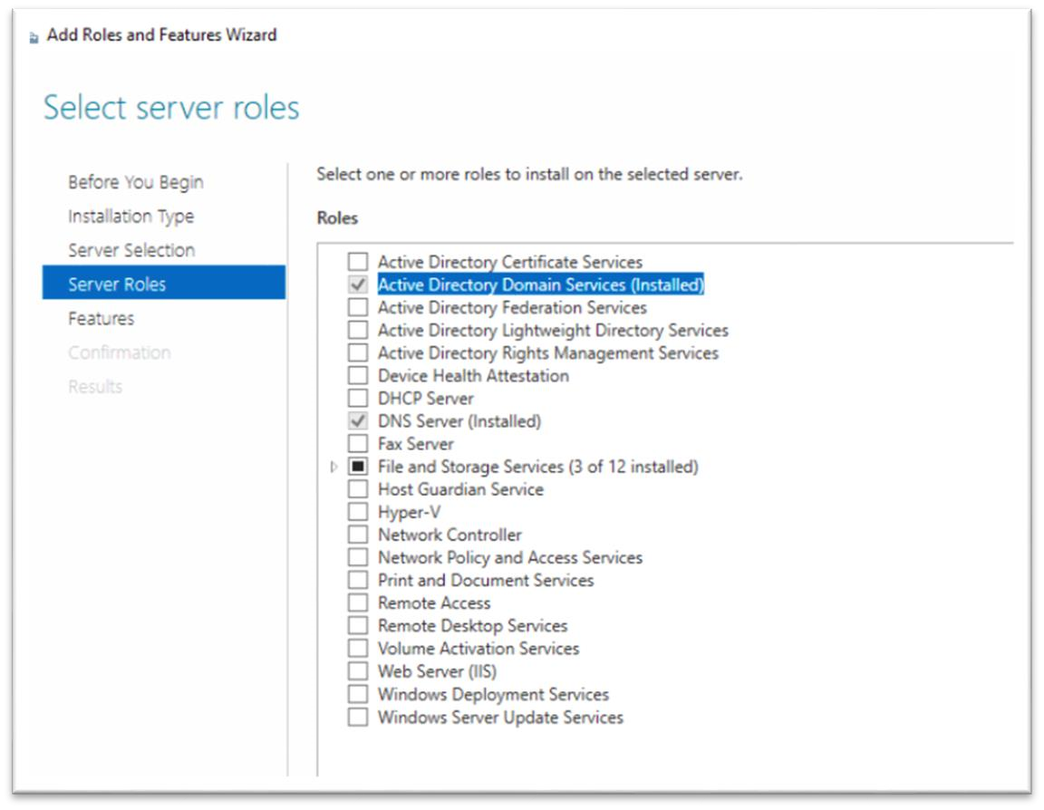

Slide 10
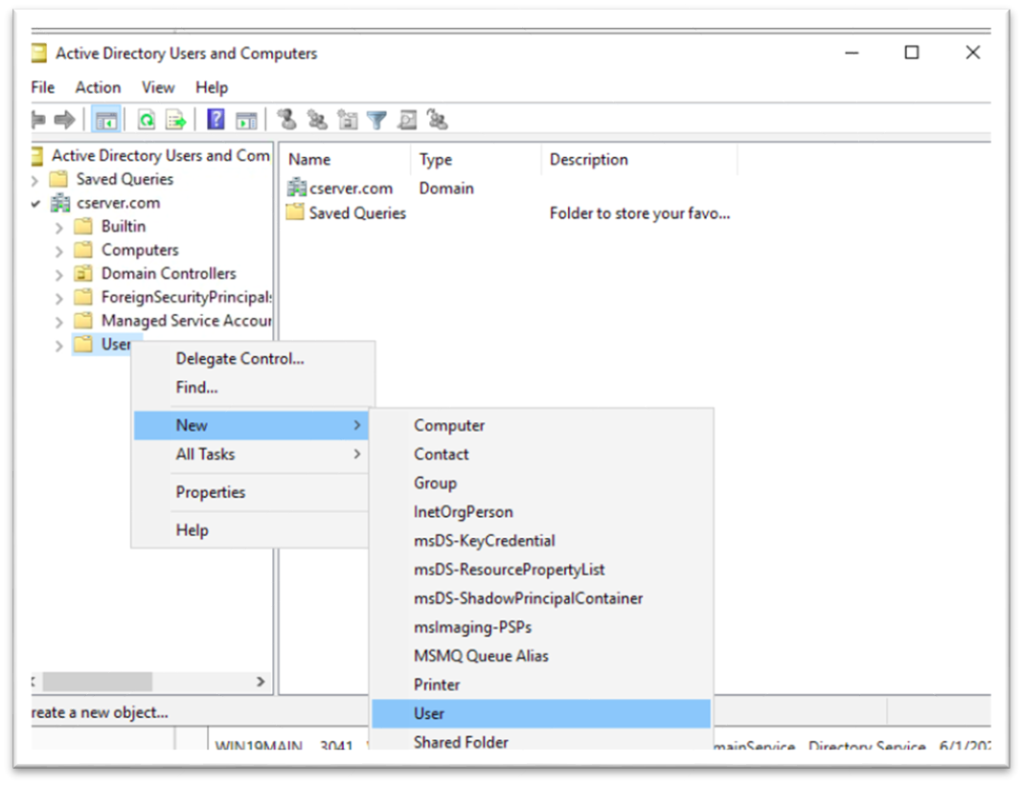
Create A Domain User
Server Manager > Tools > Active Directory Users and Computer > Expand
Domain > Right Click on user > new > User

Slide 11
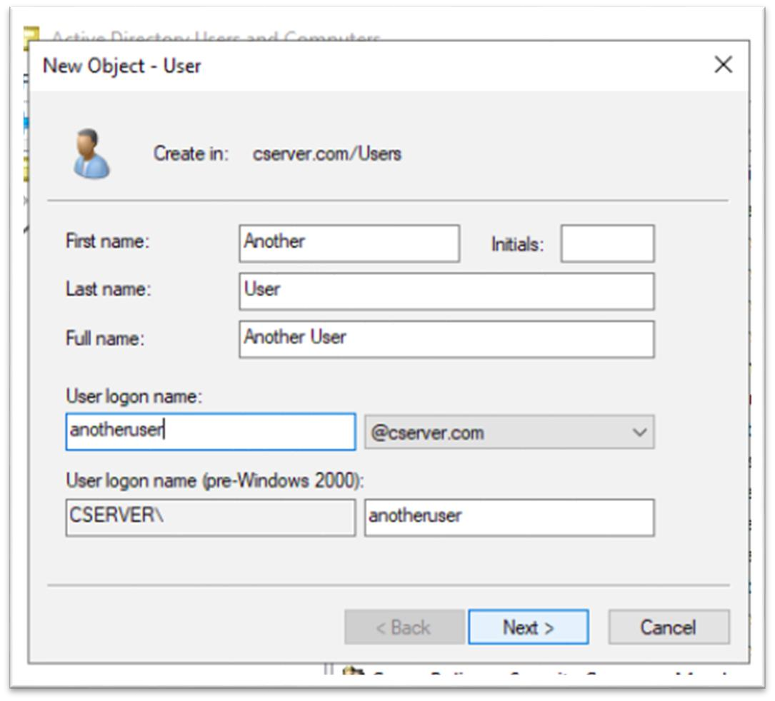

Slide 12
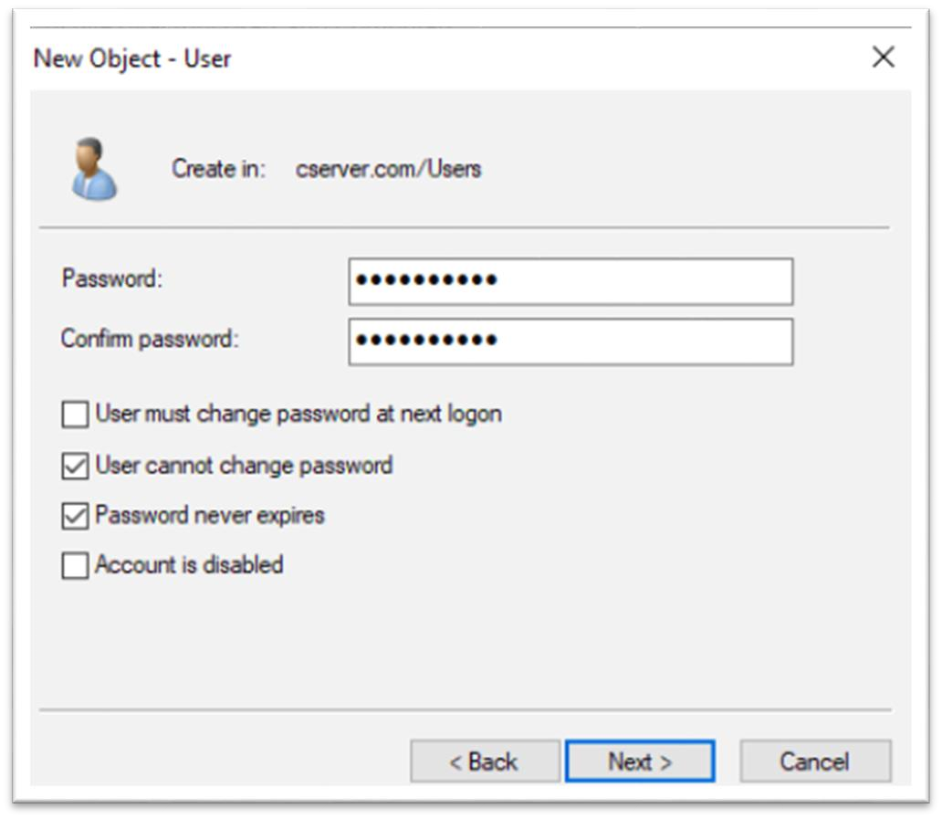
Set Password and select User cannot change password and Password never expire and next and finish

Slide 13
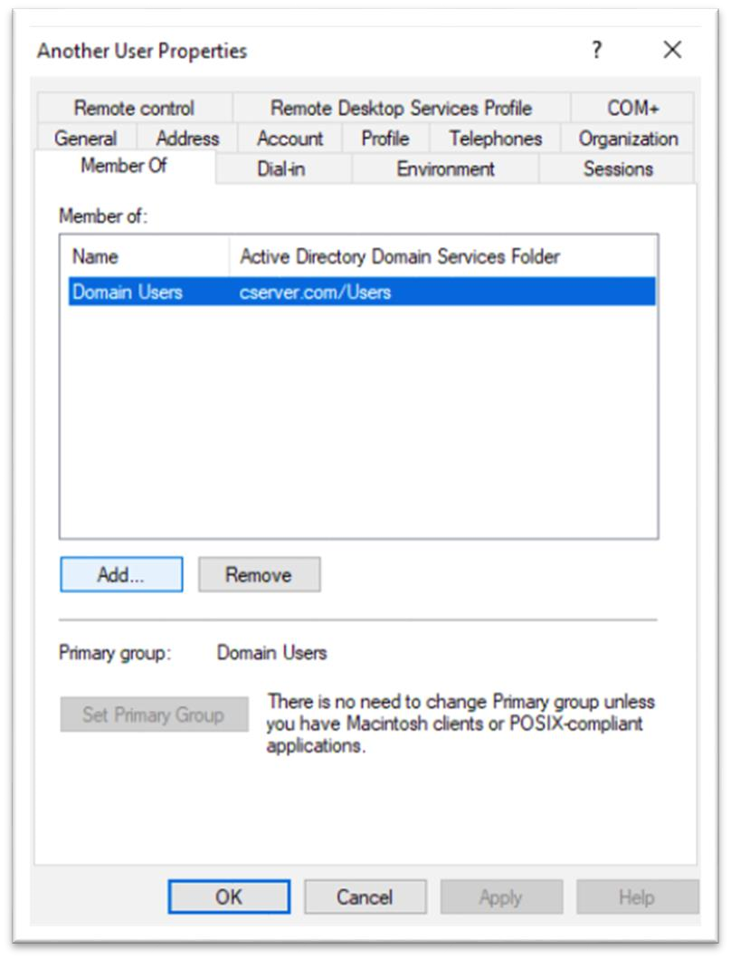
Go to Properties of newly created user > Member of and click on add

Slide 14
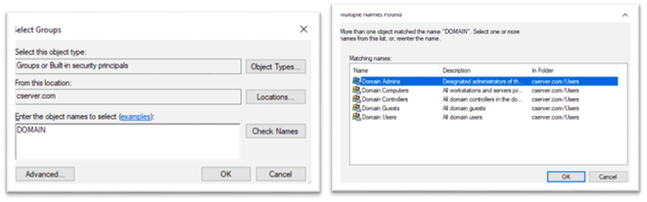
Enter Object name to Domain > Check Name > Select Domain Admin > OK

Slide 15
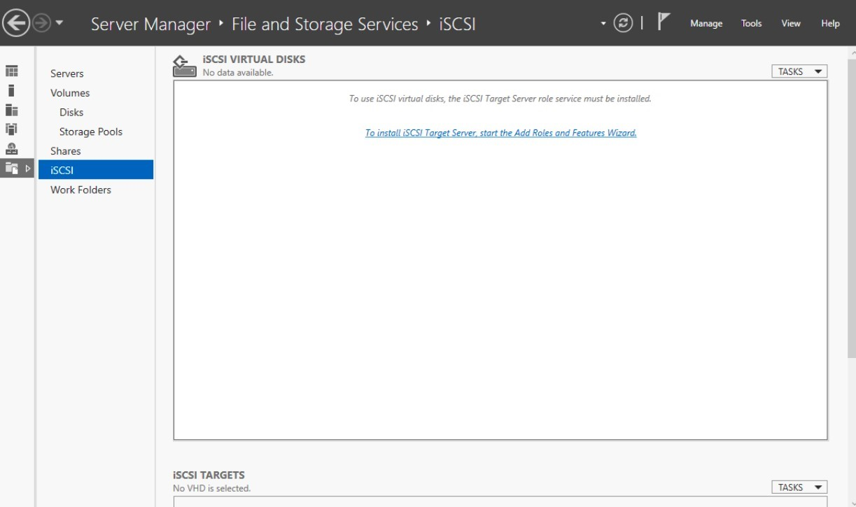
Setup iSCSI Target on Main Server After that Go to Server Manager > File and Storage Services >

Slide 16
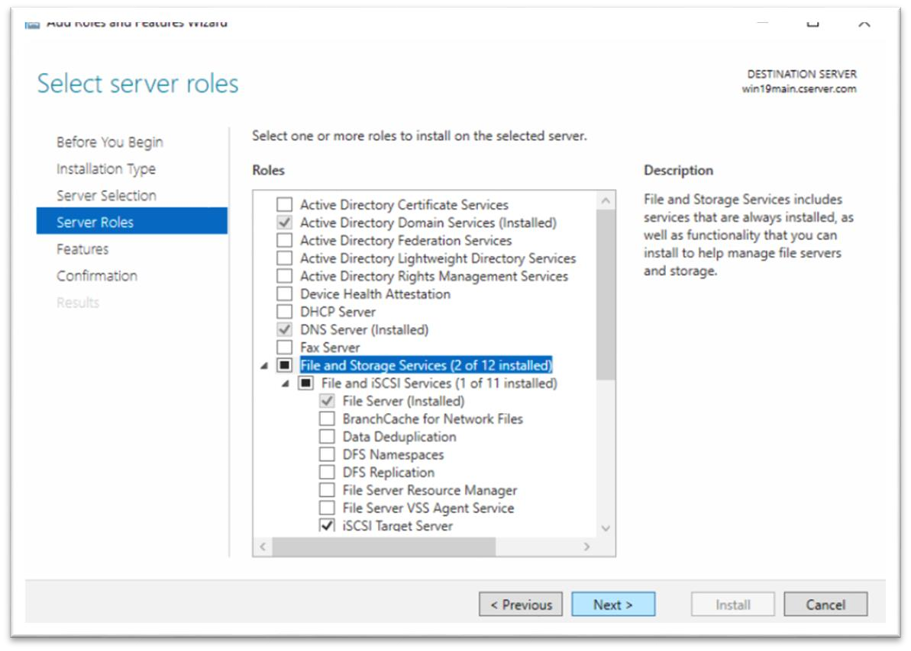
Install the required features for iscsi and reboot once

Slide 17
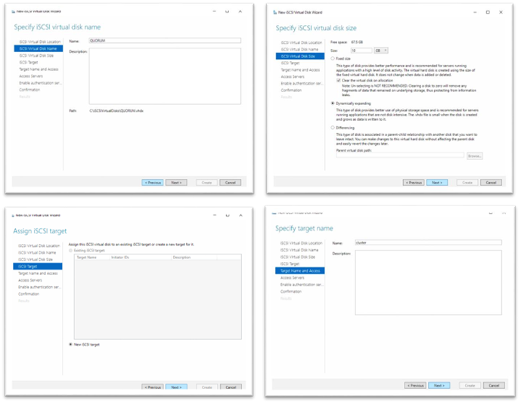
After Reboot Set Virtual disk name > Set virtual disk size and set dynamic spending > new iscsi > name target name

Slide 18
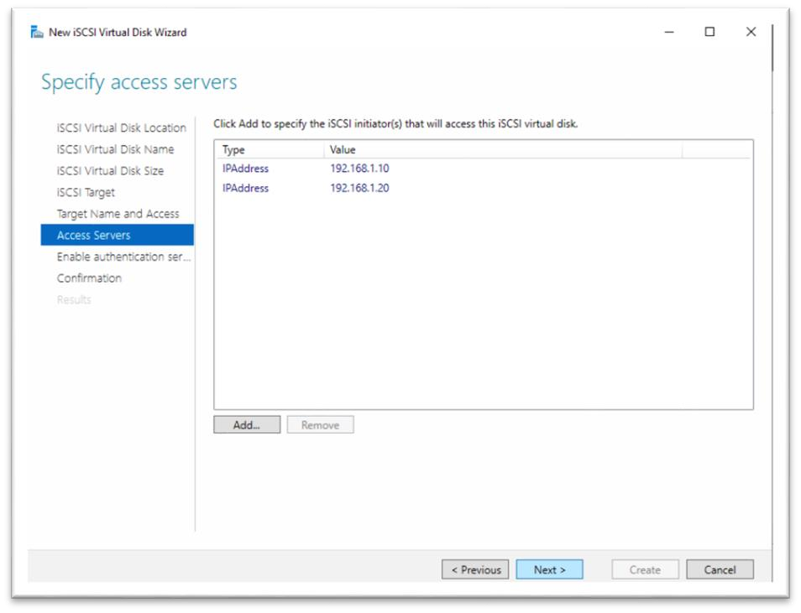

Slide 19
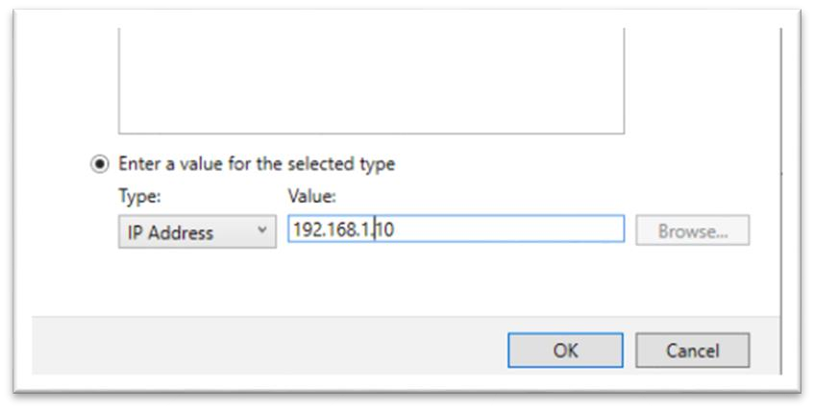
Set type IP Address and set the value 192.168.1.10

Slide 20
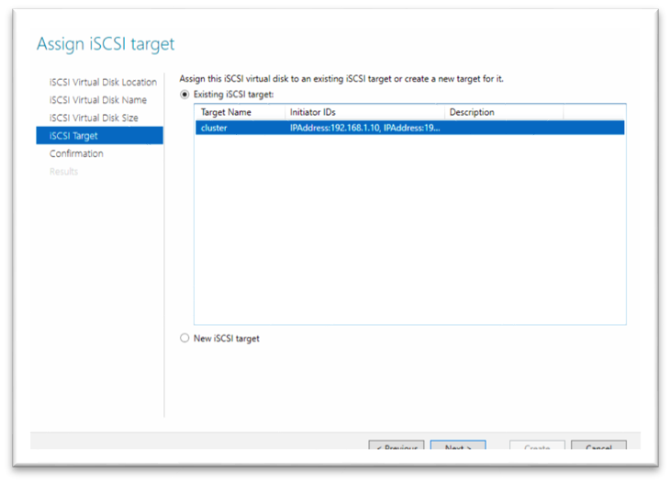
After that create another iscsi and set the storage and select existing iscsi target and create with ip – 192.168.1.20

Slide 21
Step 4 – Setup Node 1 and node 2 servers
Run Sysprep:
C:\Windows\System32\Sysprep\sysprep.exe
Select Enter System Out-of-Box Experience (OOBE) and Generalize c. Reboot
After That reboot both the os accept the license and set password
After reboot set Static ip for node1 192.168.1.10 and node2 192.168.1.20
Default gateway set to 192.168.1.1 in both the os
And dns to 192.168.1.50
Server Manager > Add roles and feature > Features > Failover Clustering > Install (Both OS) Step 5 – Setup Failover cluster
Open Any of node os
Server Manager > Failover Cluster Manager > validate Configuration

Slide 22
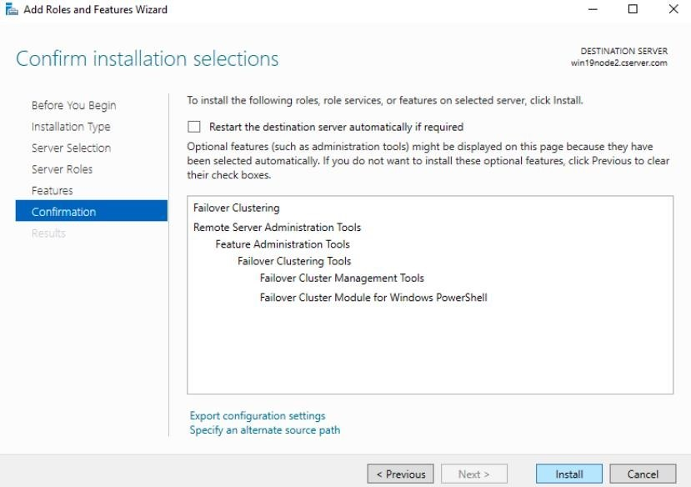

Slide 23
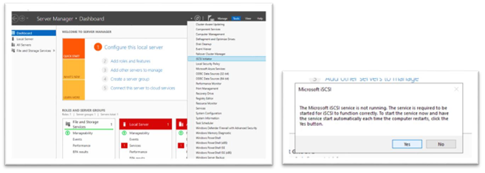
Change the names for node1 to win19node1 and node2 to win19node2 and reboot After rebooting server manager > iscsi Initiator > Click on Yes

Slide 24
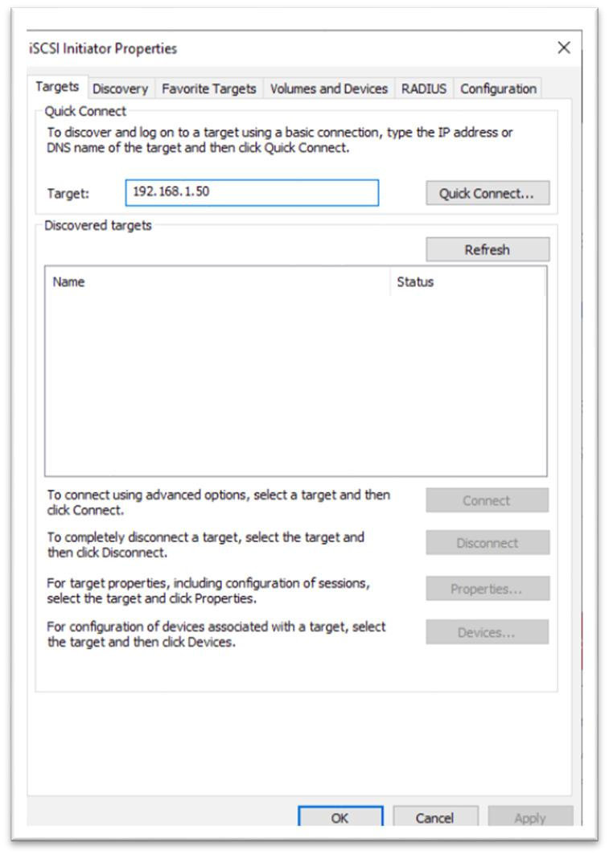
In the target set the ip to 192.168.1.50 and Quick Connect click ok

Slide 25
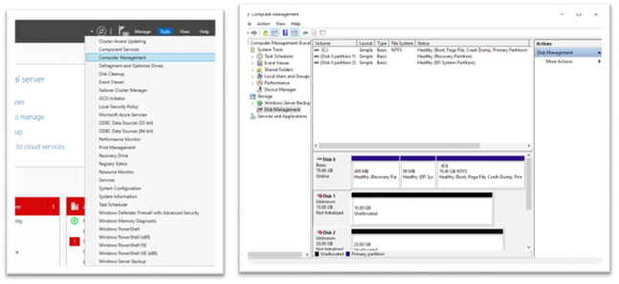
After that go to Tools > Computer management > storage > Disk Management

Slide 26
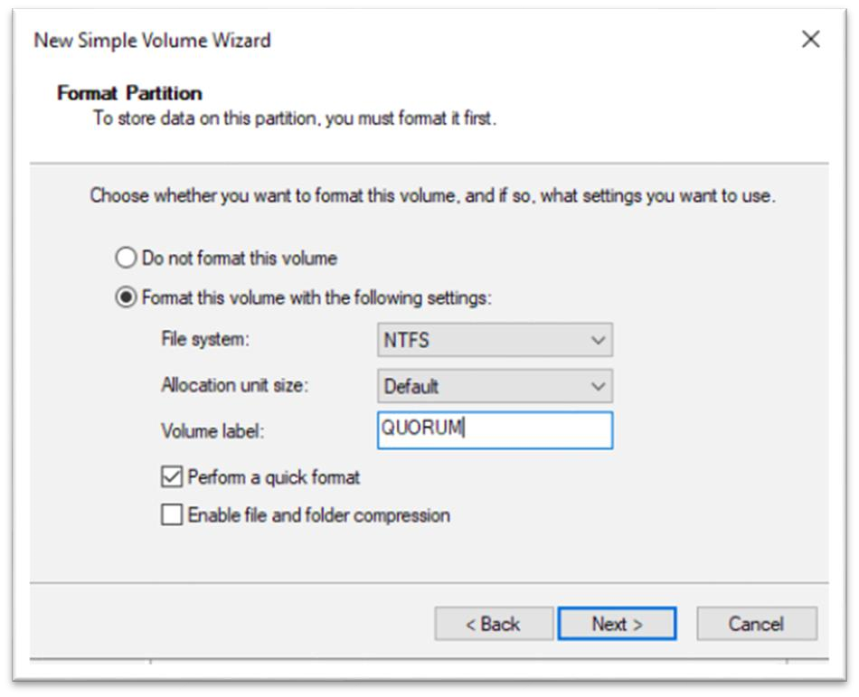
Click on online in both disks > Disk Initiate > Assign latter > set the volume name to QUORAM and DATA (Set It both the os)

Slide 27
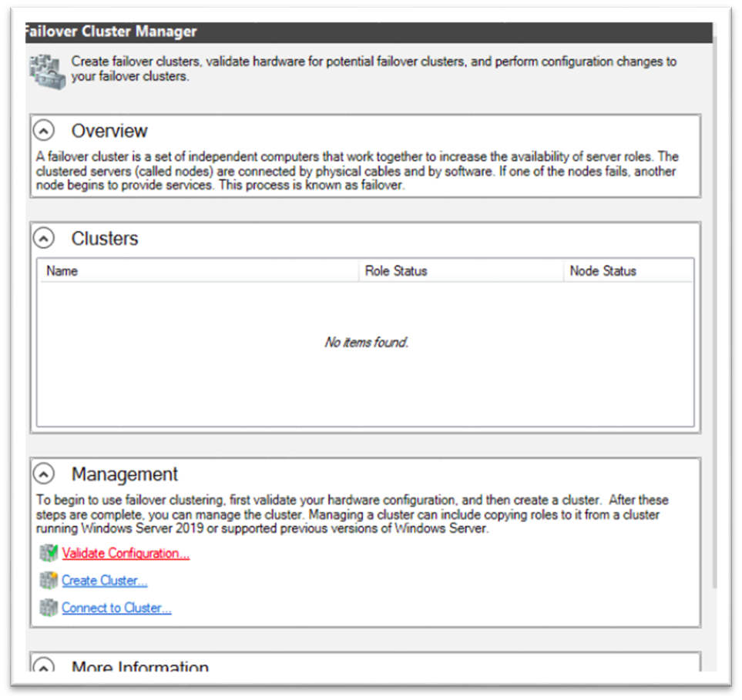
Setup Failover cluster
Open Any of node os
Server Manager > Failover Cluster Manager > validate Configuration

Slide 28
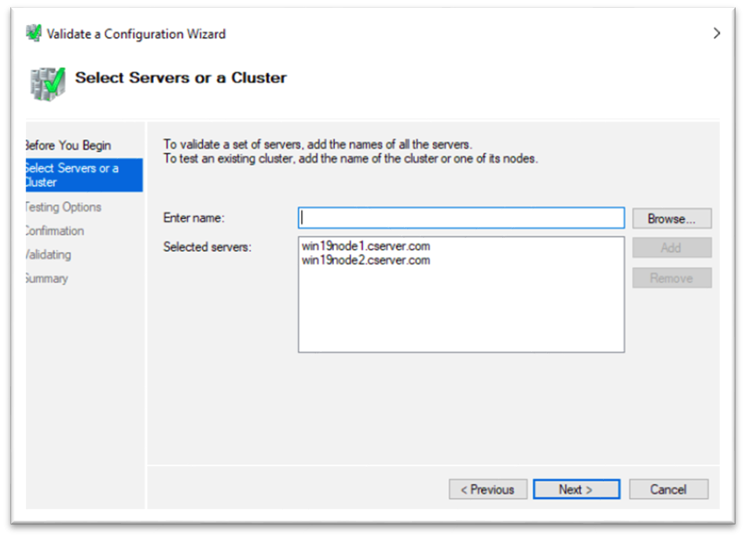
Enter node server names and add them

Slide 29
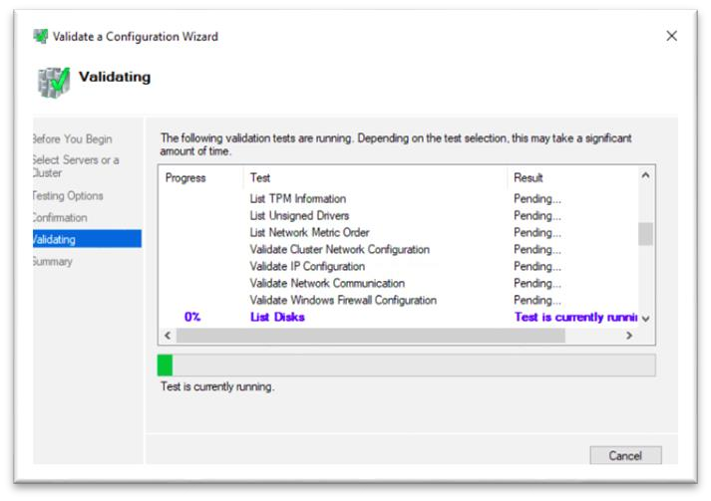
Click on run all test and next and check confirmations and start the test by click next, it takes some time to test

Slide 30
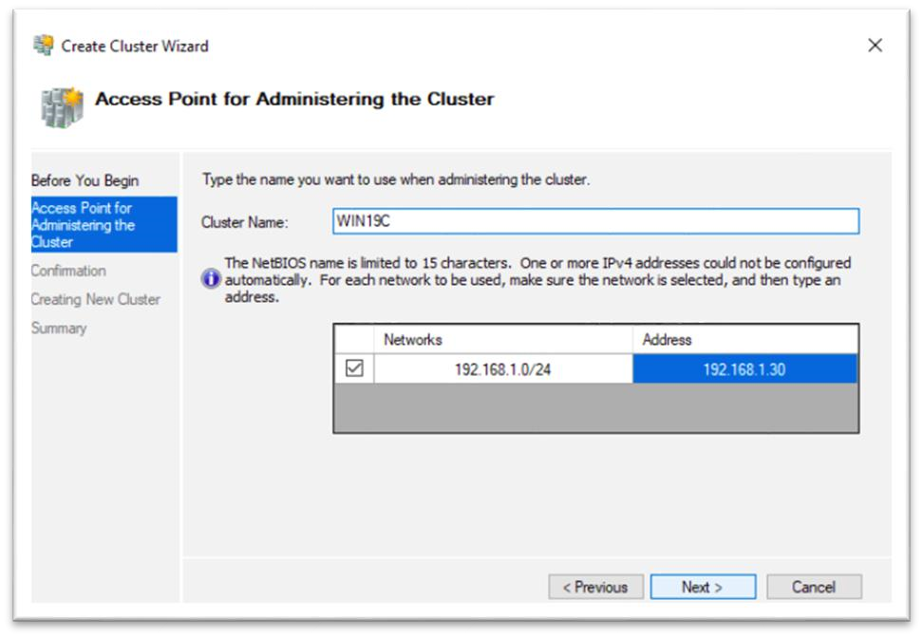
Check all the results and check on create the clusters... and click on finish. It will open another wizard
After that set the cluster name and set a cluster ip address

Slide 31
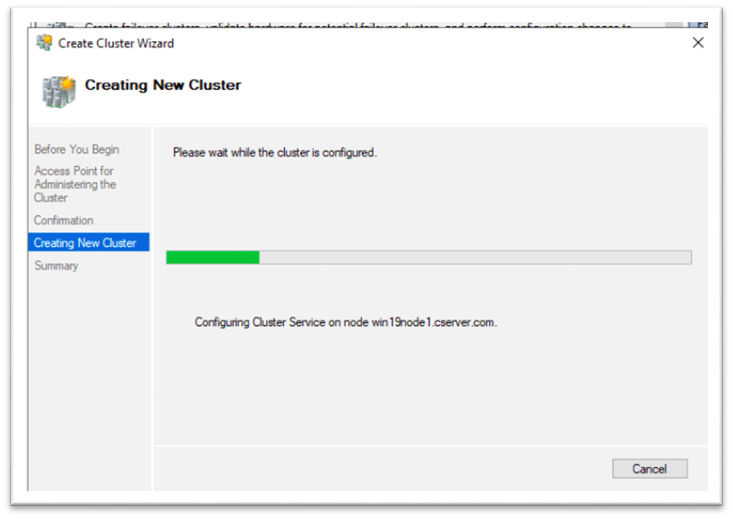
Click on next and after that its starts installing

Slide 32
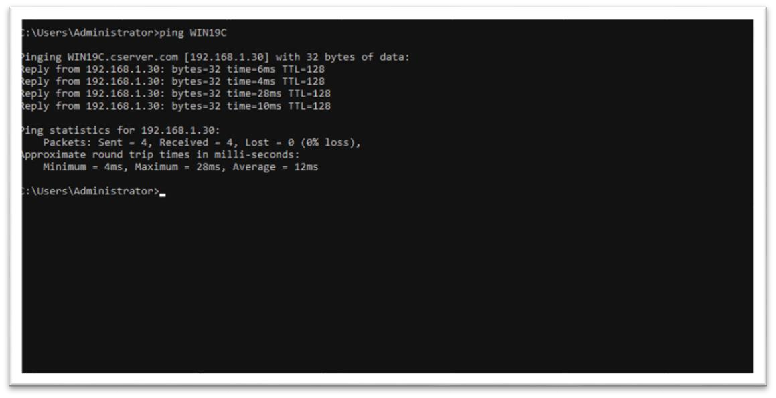
Check the installations by ping to the cluster name

Slide 33
---The end ----

